Slide 1
Data definition language (DDL) and Data manipulation language (DML)
INF08104: Database Systems
Brian Davison, 2014/15

Slide 2
Agenda
Logical design
Datatypes
DDL: creating database objects
DML: Maintaining data
The system time
Date formatting
Comparing dates
The data dictionary

Slide 3
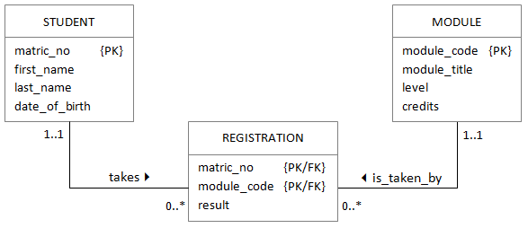
Logical design
Database type
Database platform
Datatypes
Storage
Performance

Slide 4
Datatypes
Datatype | Used for | Example
NUMBER(n) | Integer values with up to n digits | -10, 0, 1024
NUMBER(n, m) | Floting point values of up to n digits including m decimal places | 3.14159, -10.5
VARCHAR2(n) | Variable character string of maximum length n | 'Edinburgh'
DATE | A combined date and time value | 10-JAN-2014 12:24:00

Slide 5
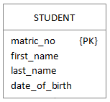
Tables
CREATE TABLE student ( matric_no VARCHAR2(8), first_name VARCHAR2(20), last_name VARCHAR2(20), date_of_birth DATE );
ALTER TABLE student MODIFY last_name VARCHAR2(25);
DROP TABLE student;

Slide 6
Integrity constraints

Slide 7
Column and table constraints
CREATE TABLE student ( matric_no VARCHAR2(8) PRIMARY KEY, first_name VARCHAR2(20), last_name VARCHAR2(20), date_of_birth DATE );
CREATE TABLE registration ( matric_no VARCHAR2(8), module_code VARCHAR2(8), result NUMBER(3), PRIMARY KEY (matric_no, module_code) );

Slide 8
Foreign keys
CREATE TABLE registration ( matric_no VARCHAR2(8)
REFERENCES student(matric_no), module_code VARCHAR2(8)
REFERENCES module(module_code), result NUMBER(3), PRIMARY KEY (matric_no, module_code) );

Slide 9
Data constraints
NOT NULL: the column must have a value
UNIQUE: the column value must be unique in the table
CHECK: the column value conforms to an arbitrary condition
CREATE TABLE module ( module_code VARCHAR2(8) PRIMARY KEY, module_title VARCHAR2(40) NOT NULL UNIQUE, level NUMBER(2) NOT NULL, credits NUMBER(2) NOT NULL );
CREATE TABLE module ( module_code VARCHAR2(8) PRIMARY KEY, module_title VARCHAR2(40) NOT NULL, level NUMBER(2) NOT NULL, credits NUMBER(2) NOT NULL );

Slide 10
Check constraints
CREATE TABLE module ( module_code VARCHAR2(8) PRIMARY KEY, module_title VARCHAR2(40) NOT NULL UNIQUE, level NUMBER(2) NOT NULL CHECK (level BETWEEN 7 AND 11), credits NUMBER(2) NOT NULL, CHECK (credits = 20 OR
(level = 11 AND credits = 10)) );

Slide 11

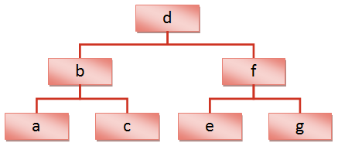
Indexes

Slide 12
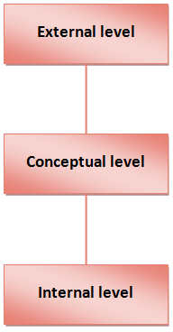
Views
Multiple views of the same data model
Query1
Query2
Query3

Slide 13
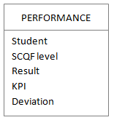
Virtual relations
CREATE VIEW performance AS SELECT s.matric_no AS "Student", m.level AS "SCQF level", AVG(r.result) AS "Result", AVG(r.result) - DECODE(m.level, 7, 56, 8, 60, 9, 65, 10, 65, 65) as "Deviation" FROM student s JOIN registration r ON s.matric_no = r.matric_no JOIN module m ON r.module_code = m.module_code ORDER BY s.matric_no, m.level

Slide 14
Synthetic keys
When there is no combination of attributes that can guarantee a unique value
To avoid composite primary/foreign keys
If there is a risk that non-unique values will appear in the future
If there is a risk that the values of a natural key might change

Slide 15
Sequences
CREATE SEQUENCE matric_seq START WITH 4000000 INCREMENT BY 1 NOCACHE NOCYCLE;
matric_no | first_name | last_name | date_of_birth
40000000 | Alan | Anderson | 12-JUN-92
40000001 | Barbara | Bennett | 20-OCT-92
40000002 | Colin | Cook | 6-MAR-93
40000003 | Donna | Davies | 17-APR-92

Slide 16
Triggers
CREATE TRIGGER matric_trig BEFORE INSERT ON student FOR EACH ROW BEGIN SELECT matric_seq.NEXTVAL
INTO :new.matric_no
FROM dual; END; /
Associated with table
BEGIN and END mark procedural statements
New value from sequence
:new indicates new table row
Forward slash runs the code
Semicolon marks the end of the PL/SQL block
dual is a dummy table

Slide 17
Summary
View
Sequence
Table
Constraint
Trigger

Slide 18
Data manipulation language (DML)
DDL: Schema objects | DML: Table data
CREATE | INSERT
ALTER | UPDATE
DROP | DELETE

Slide 19
Inserting rows
INSERT INTO <table> (<column 1>, <column 2>, ...) VALUES (<value 1>, <value 2>, ...);
INSERT INTO <table 1> (<column 1>, <column 2>, ...) SELECT <value/column 1>, <value/column 2>, ... FROM <table 2> WHERE <condition>

Slide 20
Using sequences
INSERT INTO <table 1> (<key column>, <column 2>, ...) SELECT <sequence>.NEXTVAL, <value 2> ... FROM <table 2> WHERE <condition>
With trigger:
INSERT INTO <table 1> (<column 2>, ...) SELECT <value 2> ... FROM <table 2> WHERE <condition>

Slide 21
Updating and deleting
UPDATE <table>
SET <column 1> = <value 1>,
<column 2> = <value 2>
WHERE <condition>
DELETE FROM <table>
WHERE <condition>
Write a query first to check the WHERE clause is correct

Slide 22
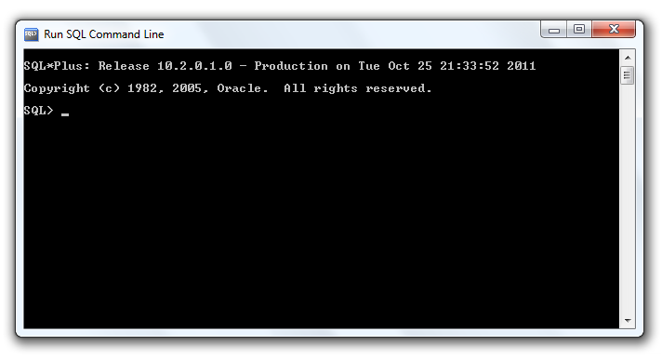
Dates and times
Internal storage format
Display formats

Slide 23
Date comparison
Decide on the exact literal date for comparison
Represent that date as a character string
Convert that string into an internal date value
Use the date value in the WHERE clause of a query

Slide 24
The data dictionary
DBA_TABLES
USER_TABLES
DBA_VIEWS
USER_VIEWS
DBA_CONSTRAINTS
USER_CONSTRAINTS

